Slide 1
HEC 1095-B Updates
Monday, June 27th, 2022

Slide 2













Get to know the new members on team
Core team
Executive team
PRODUCT
ENGINEERING
Munish Sikka
Washington DC
Product Lead
Tami Corson
North Carolina
Clinical SME / Scrum
Shashank Khandelwal
Rockville, MD
Tech Lead
Jeff Scheire
MO Studio
Marcy Jacobs
McKinsey & Co
Kevin London Frog Design
DESIGN
Thomas McCue Oak Park, IL Principal Designer Director
Carl Dickerson Atlanta, GA Content Strategist and Plain Language Content Creator
Carolyn Williams Chicago, IL Experience Designer
Teagan Stephenson Ft. Lauderdale, FL Backend Engineer
Will Reynolds SERVE Advisory
Ben Morris
Pluribus Digital
Travis Hoffmann
MO Studio
Introduction

Slide 3
Agenda
Product goal:
To create and accessible, usable, and discoverable digitized IRS 1095-B tax document on VA.gov and build for opt-in to digital delivery (paperless option).
1095-B MVP
Blockers
Next steps
Status of 508 accessibility work
Working with VA Notify on initial email announcing launch
Opt-in to Digital Delivery of 1095-B
New web page designs for HEC approval
Preparing for legal review
Building email notification triggers (opt-in/opt-out, annual)
Building profile - DFAS example
 | We welcome all feedback! Feedback will be collectively reviewed and prioritized appropriately based on where it stacks against other stories in the backlog as well as technical feasibility.
Agenda

Slide 4




1095-B Workplan v7
Owned by design team
Owned by product/ engineering team
Release
WE ARE HERE
SPRINT 7
4/20 – 5/03
SPRINT 8
5/04 – 5/17
SPRINT 9
5/18 – 5/31
SPRINT 10
6/01 – 6 /14
SPRINT 11
6/15 – 6/28
SPRINT 13
6/29 – 7/12
SPRINT 14
7/13 – 7/26
SPRINT 15
7/27 – 8/09
SPRINT 16
8/10 – 8/23
SPRINT 17
8/24 – 9/6
1095-B: Spanish translation docs
1095-B: Spanish translation opt-in docs
Turnover document of remaining post-MVP work (VA notify, 2022 IRS form, 508 compliance, multiple year selection)
1095-B: Legal Review
1095-B: Legal Review – Opt-in
Product & Delivery
VA 508 Assistance request
Align on launch MVP v. MVP w/ opt-in
User Experience & Design
Design for opt-in
Launch communication plan
Notification flow
1095-B Wayfinding
Tech feasibility opt-in build / Notification triggers
Tech feasibility wayfinding
Engineering & Development
Build for opt-in
Build for wayfinding
Build Analytics & launch monitoring
Collaboration Cycle
Call center review
1095-B Launch
1095-B Post launch evaluation
Sitewide and Content IA ticket
06-14 Sprint 4 Demo
Workplan

Slide 5
1095-B MVP
HEC 1095-B Updates

Slide 6
Blockers for 1095-B MVP launch
BLOCKER | OWNED BY | ACTION NEEDED | DATE ENTERED | STATUS | NOTES
PDF Accessibility | Tarsha Tremble (Business Owner) | Ticket in for assistance from VA 508 office Troubleshooting data format as a block to accessibility Exploring alternate format for 1095-B production for those with sight readers Potential alignment with IRS on HTML build | Sprint 3 – 3/3/22 |  | Ongoing work to resolve
Spanish Translation | Tarsha Tremble (Business Owner) | Follow up with content finalization and translation progress | Sprint 10 – 6/14/22 |  | June 28 expected date
06-14 Sprint 4 Demo
1095-B Blockers

Slide 7
1095-B MVP remaining actions, with external dependencies
ITEM | WORK STREAM | ACTION NEEDED | TARGET COMPLETE DATE | PREREQUISITE
Launch | Product & Tech | Work with tech to create a vets-website release | July 2022 | 508 solution
UAT | Product & Tech | Follow Collaboration Cycle guidelines for UAT Identify Veterans within VA to conduct UAT, send access, and follow up to ensure testing complete | TBD | Product dark launched
Post Launch Check- In | Product | Complete Collaboration Cycle milestone to KPIs post launch | TBD (One month after launch and announcement) | Product launched in prod
Links from VA.gov pages to 1095-B | Product & Design | Work with IA team to have other identified pages within VA.gov (e.g., ACA page) link to the 1095-B page Work with IA team to have 1095-B page added to navigation and be found in VA.gov search | June or later | Product launched in prod; aligned on comm plan with Tarsha, Tracey
1095-B update strategy | Product | Align on who will own 1095-B long term, including updating the PDF template each year | May or later | Product complete and launched in production
Communications to announce launch | Product & Design | Work with Tarsha and HEC team to refine drafted communications and align on plan and timeline to announce 1095-B launch to Veterans Work with VA Notify team to build and launch communications on their platform | October - December 2022 | Product launched in prod; aligned on communication plan with Tarsha/Tracey
06-14 Sprint 4 Demo
1095-B Remaining actions

Slide 8
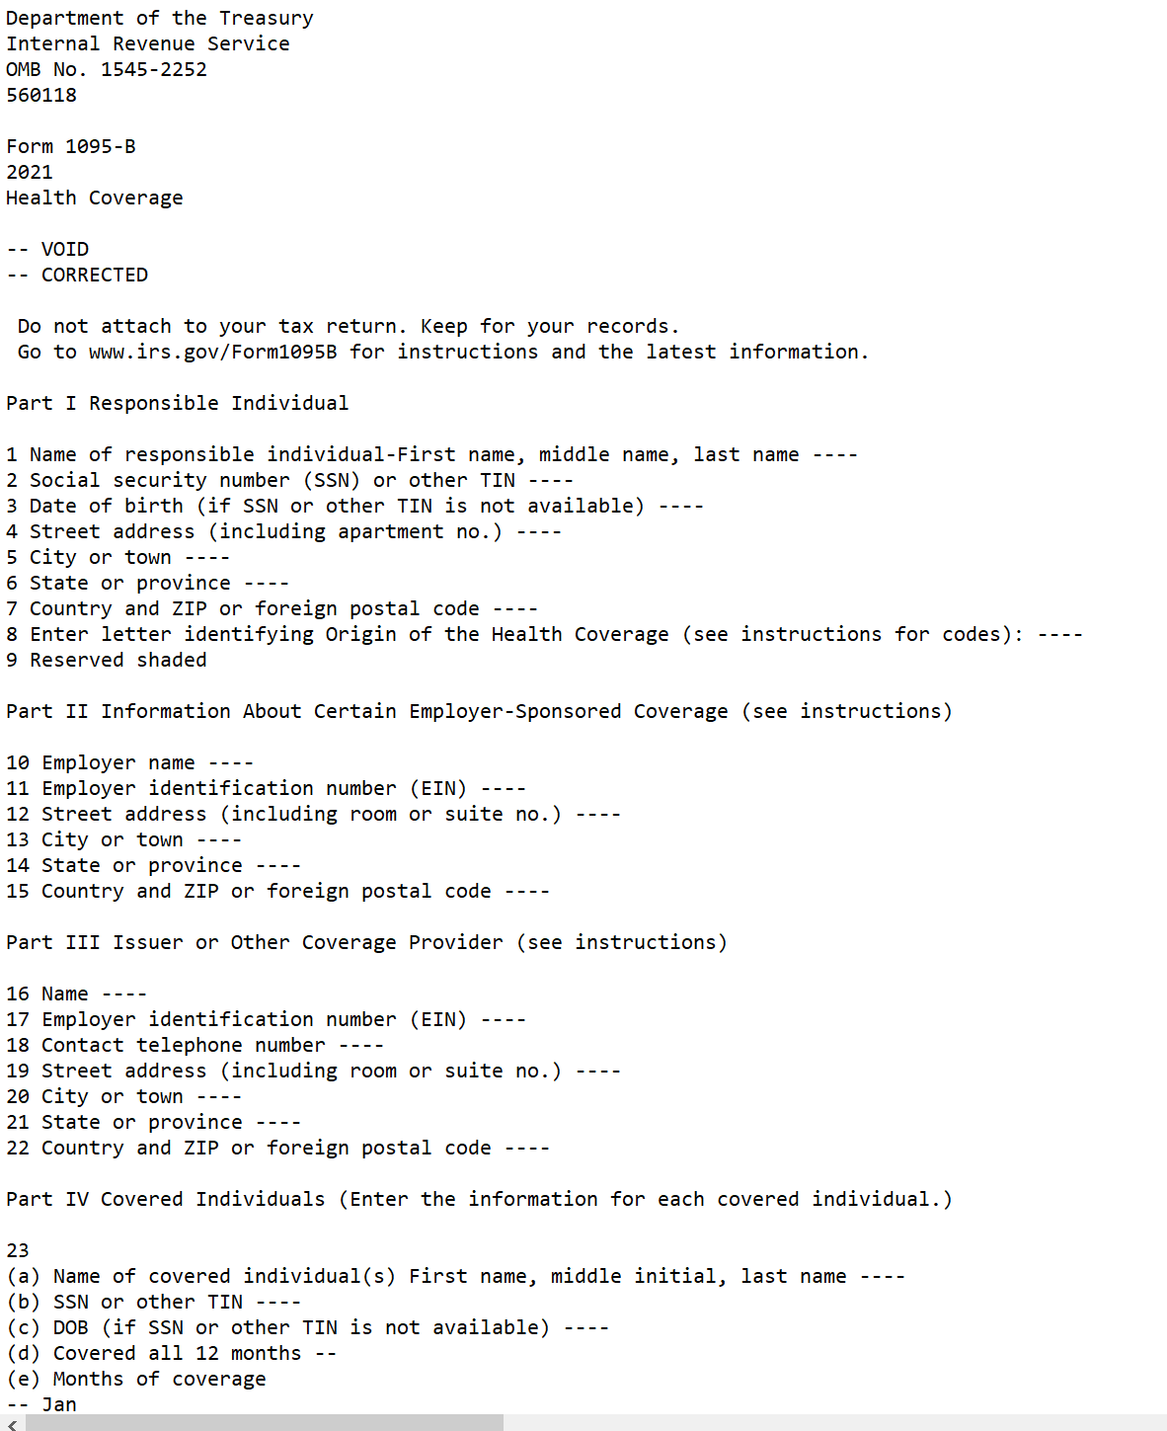

C
508 Accessibility Analysis
Team reviewed populated 1095-B document with screen reader technology:
Blank PDF from IRS - Passed
Flat data - Failed
Non-flatten data - Failed
Form without privacy data - TBD
Options to investigate:
Use text version of 1095-B (discussion on next page)
Offer PDF and text options
Have IRS build 1095-B HTML
Fix privacy data, if issue, and continue with 1095-B as built
1095-B Text version
1095-B
8

Slide 9
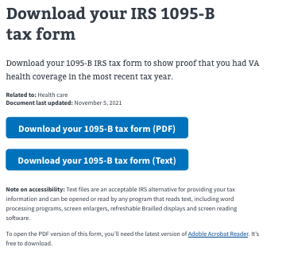
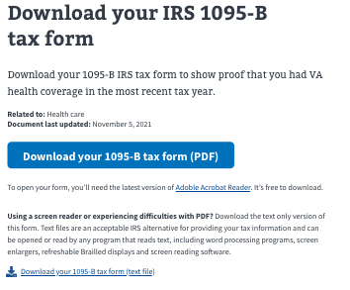
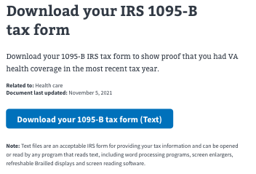
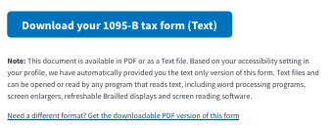
IRS 1095-B text document options
Options:
Build a second widget / content for sight deficient to upload text version of 1095-B
Expand current widget with second primary button and content for downloading text version of 1095-B
Change output of widget to text version only and amend content to express that output of current widget would be text version of 1095-B
Change widget to personalize output based on sight status of veteran. Amend content to include language to express this personalization.
1095-B Sketch file
1095-B
9

Slide 10
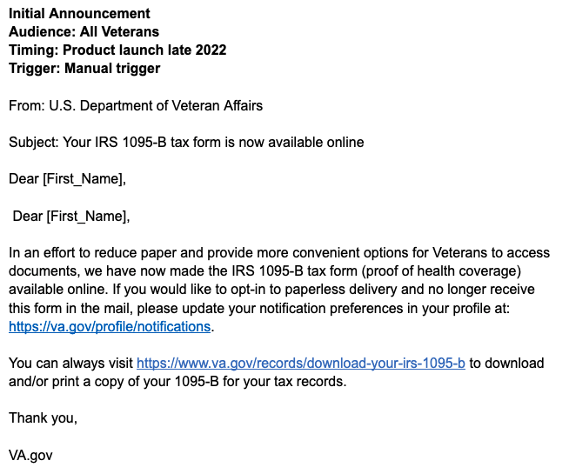
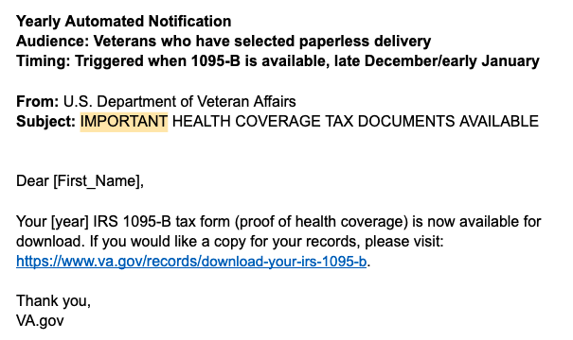
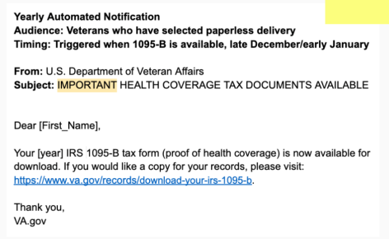
D
Building Triggers for notification
Initial Notification of enrollees:
“Blast” email notification
Manual trigger by 1095-B Team or HEC
Notification letter content created and build into VA Notify
Annual notification of enrollees of new tax year 1095-B:
Selective email to those who are opt-in to email notifications
Trigger built by 1095-B team to roll when new tax template uploaded
Notification letter content created and built into VA notify by 1095-B team
Link
1095-B
10

Slide 11
1095-B Opt-in to Digital Delivery
HEC 1095-B Updates

Slide 12
Potential Blockers for 1095-B Opt-in
BLOCKER | OWNED BY | ACTION NEEDED | DATE ENTERED | STATUS | NOTES
Legal Review | Tarsha Tremble (Business Owner) | Office of General Counsel to understand requirements and perform legal review | 6/14/2022 |  | OGC will also have to approve VA Profile opt-in build
Spanish Translation of HEC documents w/ Opt-in content | Tracey Mulrooney (Product Owner) | Follow up with content finalization and translation progress | Sprint 10 – 6/14/22 |  | June 28 expected date
06-14 Sprint 4 Demo
1095-B Blockers

Slide 13
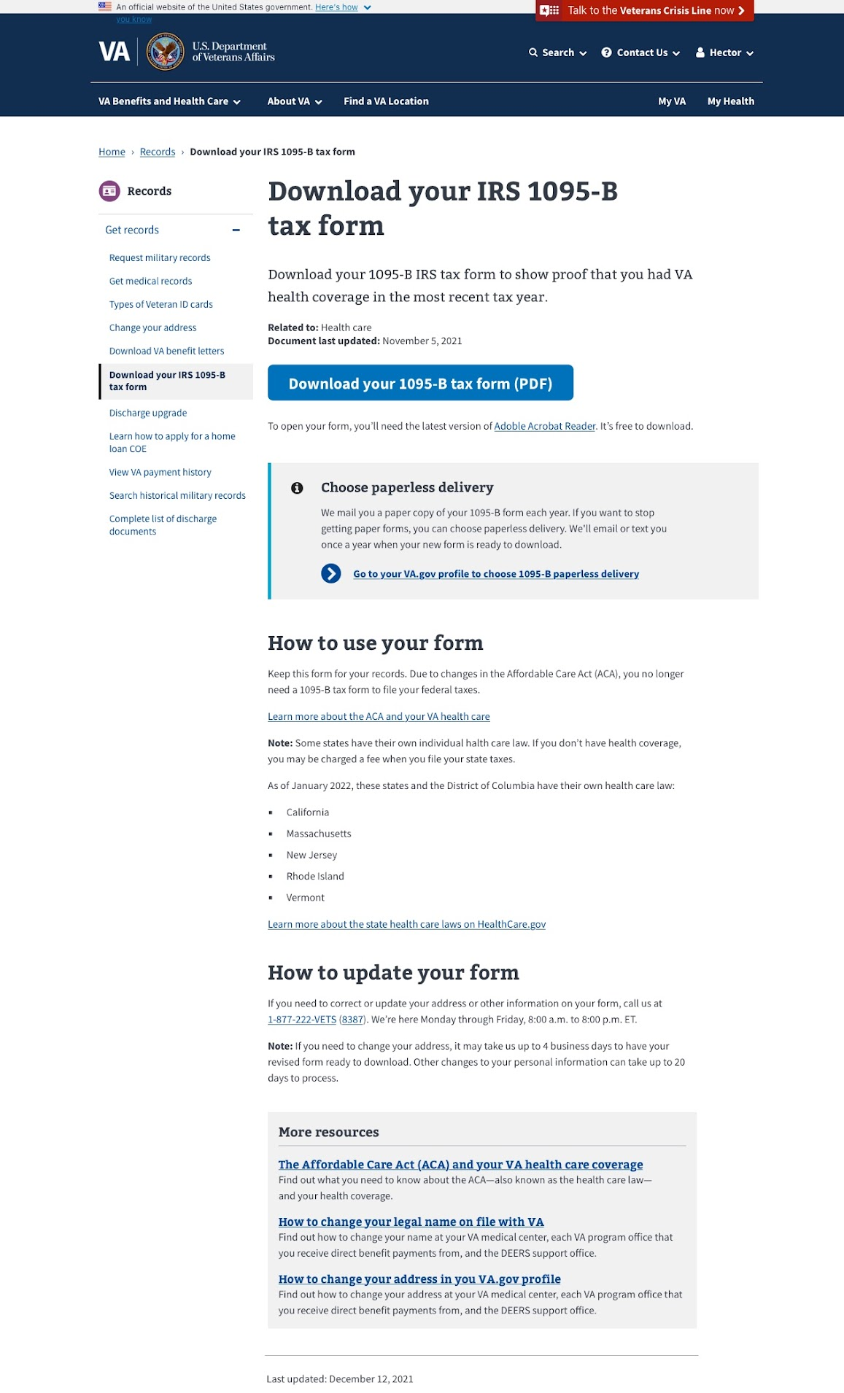
A
Design for opt-in to digital delivery of 1095-B
Requirements:
Provide communication and path to user profile allowing users to opt-in for digital form retrieval only
Design Considerations:
Plain language instructions
Clearly define the “what for” of this information
Placed near digital download button to reinforce association with form retrieval function
Component selection that frames and highlights without distracting
1095-B Sketch file
1095-B
13

Slide 14
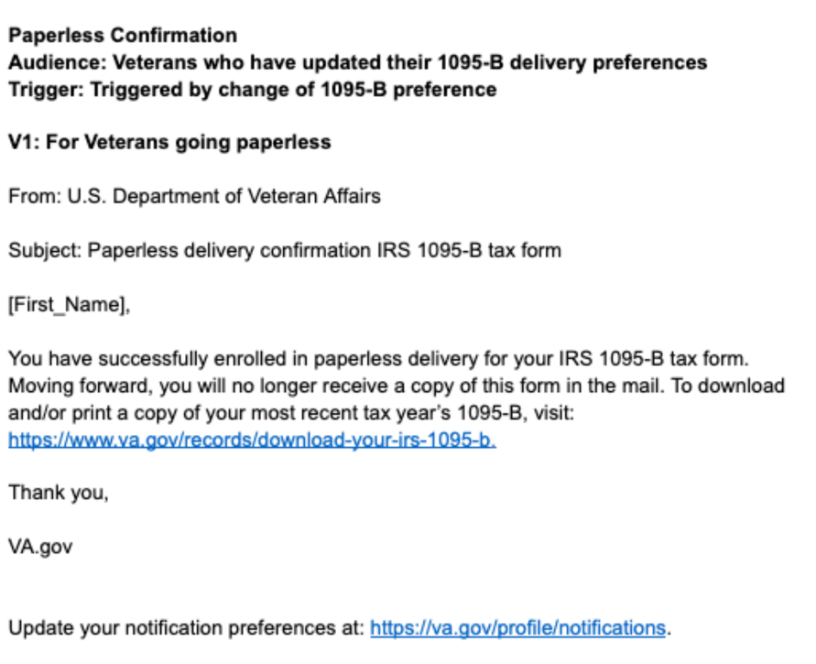
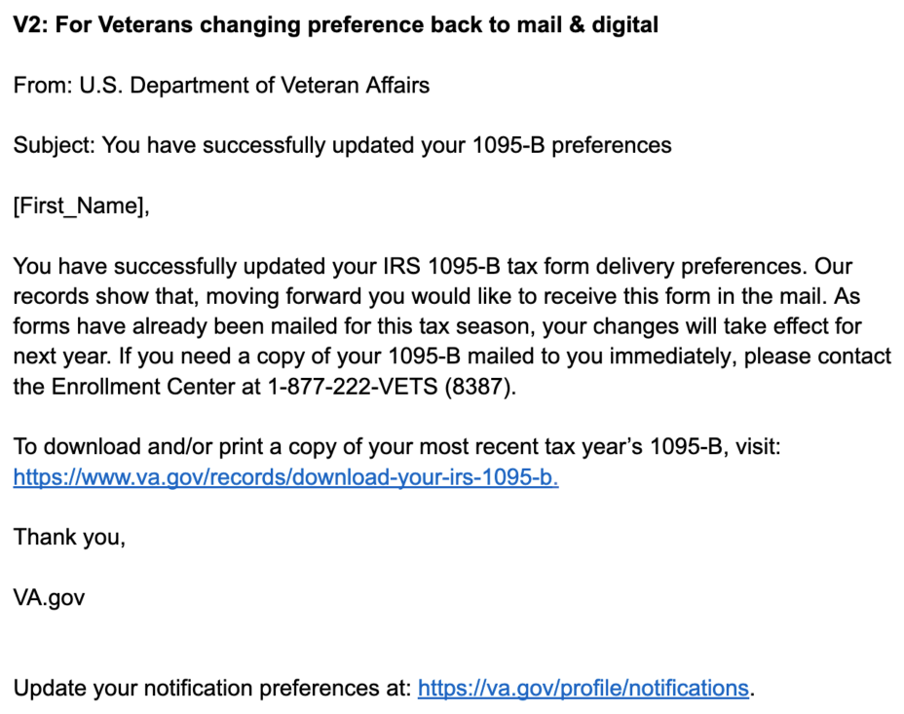
B
Preparing for legal review
Legal guidance:
2021 Instructions for forms 1094-B and 1095-B (12.9.2021) - link
21st Century Integrated Digital Experience Act - link
26 CFR 1.6055-2 Electronic Furnishing of Statements - link
Summary – Presidential Executive Order on Transforming Federal Customer Experience and Service Delivery to Rebuild Trust in Government – link , EO link
Initial Notification of opt-in:
Notification of opt-out:
DFAS Exp Mural
1095-B
14

Slide 15
1095-B Opt-in remaining actions, with external dependencies
ITEM | WORK STREAM | ACTION NEEDED | TARGET COMPLETE DATE | PREREQUISITE
Launch MVP | Product & Tech | Work with tech to create a vets-website release | July | 508 Exception request
1095-B Opt-in build | Product | Follow up with HEC and Profiles team to ensure 1095-B opt-in is done Ensure changes in profile reflect in HEC to prevent mail of those that opt-in Update draft communications and announcement plans, based on when opt-in will be launched | June - Aug | Legal review
Notification Triggers | Design & Tech | Notification letters approved by legal Build triggers for opt-in, opt-out, annual update |  | Legal review
Legal Review | Product | Work with Tarsha to complete legal review for Opt-In | June – Aug | POC name from Tarsha
Communications to announce launch | Product & Design | Work with Tarsha and HEC team to refine drafted communications and align on plan and timeline to announce 1095-B launch to Veterans Work with VA Notify team to build and launch communications on their platform | October - December 2022 | Product launched in prod; aligned on communication plan with Tarsha/Tracey
Launch opt-in | Product & Tech | Work with tech to create a vets-website release | September - October 2022
1095-B Remaining actions

